Slide 1
HL7 FHIR PROFILING
Webinar
Lloyd McKenzie
October 19-21, 2021

Slide 2

Who am I?
Name: Lloyd McKenzie
Company: Gevity (part of Accenture)
Background:
One of FHIR’s 3 initial editors
Co-chair FHIR Management Group and FHIR-Infrastructure
HL7 Fellow
Heavily involved in HL7 and healthcare exchange for last 20+ years (v2, v3, CDA, etc.)
lmckenzie@gevityinc.com

Slide 3

This presentation
Can be downloaded here:
https://github.com/FHIR/documents/tree/master/presentations/2021-10%20Webinars
Is licensed for use under the Creative Commons, specifically:
Creative Commons Attribution 3.0 Unported License
(Do with it as you wish, so long as you give credit

Slide 4
Credit
Most of these slides were prepared by Michel Rutten of Fire.ly
With updates by Lloyd McKenzie & Richard Ettema

Slide 5
Contents of this tutorial
Need for profiles
Profiling Overview
Profiling Terminology
Profiling Structures
Slicing
Formal Constraints
Extensions
Logical Models
Implementation Guides
Other Conformance Resources
Registries
FSH

Slide 6
Hands-on approach
“hands-on” exercises for key content
For some, time to perform “in class” with discussion/questions
Feel free to explore further on your own time
‘Completed’ examples available on Git
https://github.com/FHIR/documents/tree/master/presentations/2021-10%20Webinars
All exercises can be completed without installing software
Online registration may be required

Slide 7
Other considerations
PLEASE ask questions
Come off mute to ask – or use the chat option
Mute when not asking questions
Two screens might be helpful
Work on your own and follow along
If you have questions between classes or after class:
https://chat.fhir.org/#narrow/stream/179177-conformance

Slide 8

Who are you?
Notes:
https://www.mentimeter.com/s/79e6430867b4780a579e67e487a9e33c/670b85505b8b

Slide 9
Need for Profiling

Slide 10
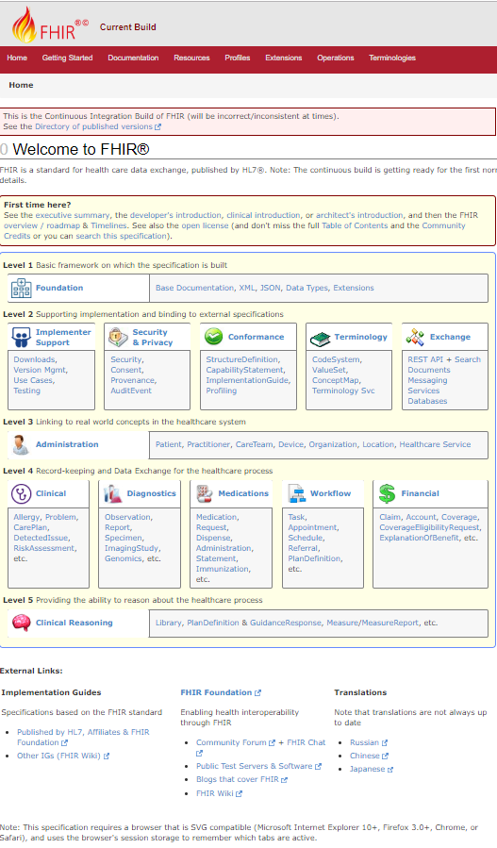
FHIR = magic?
FHIR is a standard for interoperability
Therefore: If two systems both comply with FHIR, they’ll fully interoperate
True or false?
Why?

Slide 11
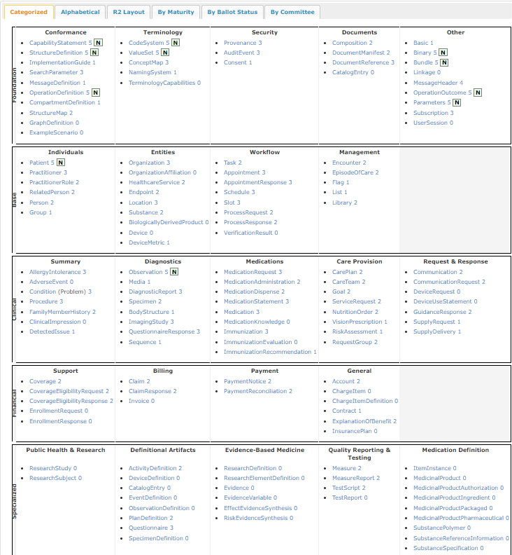
FHIR Resources
140+ resources
How many real systems will support all of these:
CarePlan, SubstancePolymer, PaymentReconciliation, CompartmentDefinition, …

Slide 12
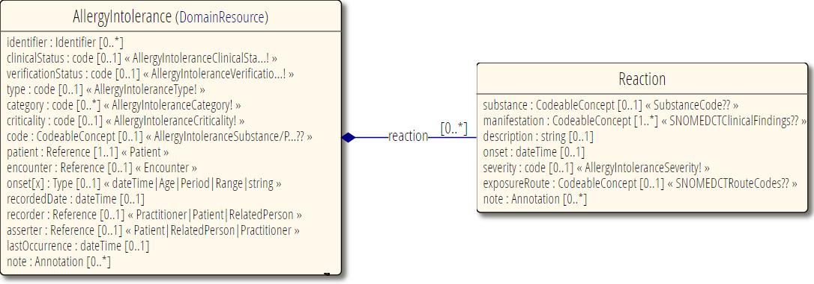
Interoperability - Elements
Most elements are optional
All data type components are optional
Most terminologies unconstrained

Slide 13
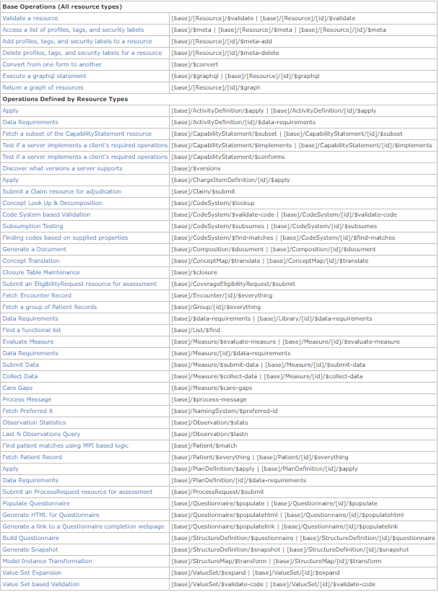
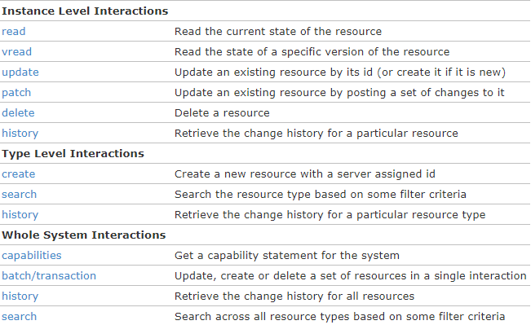
Operations & behavior
Plus custom operations, documents, messages, etc.

Slide 14
The need for profiling
Many different contexts in healthcare, but a single set of Resources
FHIR provides a “platform specification”
Standard building blocks for interoperability solutions
Requires further adaptation to context of use

Slide 15
The need for profiling
Need to be able to describe adaptations based on use and context
What resources and elements are used?
What API features are used?
What terminologies are used?
How to map these to local requirements/implementations?

Slide 16
The need for profiles
Allow for these usage statements to be:
Authored in a structured manner
Published in a repository
Used as the basis for validation, code, report and UI generation.

Slide 17
Profile-less FHIR
You don’t need profiles to interoperate with FHIR
Resources are “discrete” enough that mechanisms to populate most elements is clear
Approach
Populate/consume all elements you know, use HL7 or country-standard extensions for extras
Map to/from “recommended” terminologies as much as possible, populate CodeableConcept.text
Expose capabilities in CapabilityStatement resource
Notes:
With profile, they can interoperate ‘ok’.

Slide 18
Lets look at some profiles
http://hl7.org/fhir

Slide 19
Profiling Overview And General Principles
Notes:
Time start-10:00 (10 minutes)

Slide 20
FHIR “Profile”
A set of constraints on a FHIR resource
A set of constraints on another FHIR profile
But also refers to:
An implementation guide
A conformance package

Slide 21

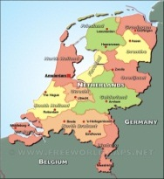

Who publishes?
http://www.hl7.org/fhir/StructureDefinition/iso-21090
http://www.hl7.nl/fhir/StructureDefinition/patient-nl
http://www.health4all.org/fhir/StructureDefinition/
Notes:
“Drive-by” or “bottom-up” operability: “Communicate first, standardize later”
First, business partners. Then, collaborations, communities. Maybe, finally, nation-wide
It’s a natural process that people will want to make it work first, then only coordinate what they really need to, and then realize they can broaden their approach to a community.
“Support”, of course top-down should still be possible! Maybe even a combi in the long-term

Slide 22
Layered profiles
More specific
Core
National
Organizational
Regional
All instances
National instances
Organizational instances
Regional instances
More generic
Conform to
Conform to
Conform to
Conform to
Volume
Volume

Slide 23
Conformance Resources
Terminology
ValueSet
ConceptMap
Content
StructureDefinition
Operations
OperationDefinition
SearchParameter
Misc.
CapabilityStatement
TestScript
Compartment Definition
Implementation Guide
CodingSystem
GraphDefinition
ExampleScenario
StructureMap
MessageDefinition
NamingSystem

Slide 24
Terminology
Define mappings between terms from different systems
ConceptMap
Set of codes for a particular use
ValueSet
CodeSystem
Define a set of concepts and their codes
NamingSystem
Define identifier and coding “systems”

Slide 25
Content
StructureDefinition
Define resources & data types
Define constraints & extensions
StructureMap
Syntax independent transformation of FHIR & non-FHIR instances
GraphDefinition
Defines collection of inter-related resources for query, update, etc.
Notes:
http://Hl7.org/fhir/stu3/conformance-module.html#roadmap
“The exact role of "Data Element Definitions" is still being studied”
R4: DataElement has been removed

Slide 26
Operations
Define additional (custom) operations
SearchParameter
Define additional (custom) searches
OperationDefinition
Compartment Definition
Define access to (related) resources
MessageDefinition
Define message events, content & allowed responses

Slide 27
Miscellaneous
CapabilityStatement
Define set of compliance tests against a FHIR server
Define how to use FHIR in a specific use case
TestScript
Define (actual or required) server capabilities
ImplementationGuide
ExampleScenario
Walks through a workflow showing how resources work together

Slide 28
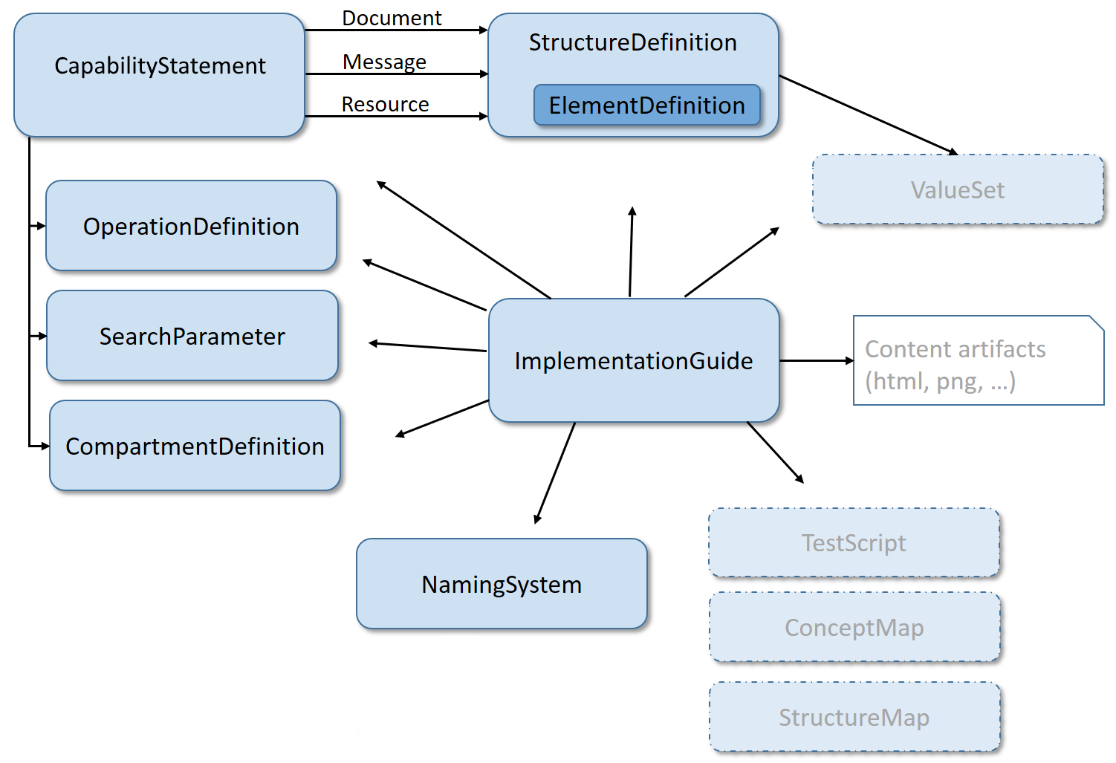
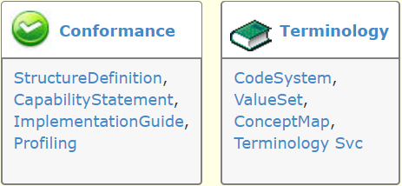
Modules

Slide 29
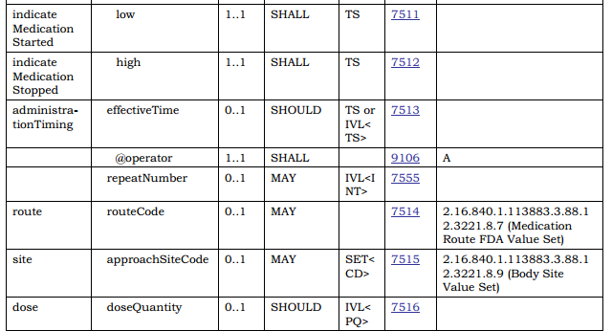
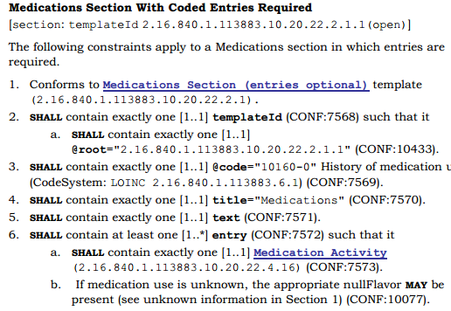
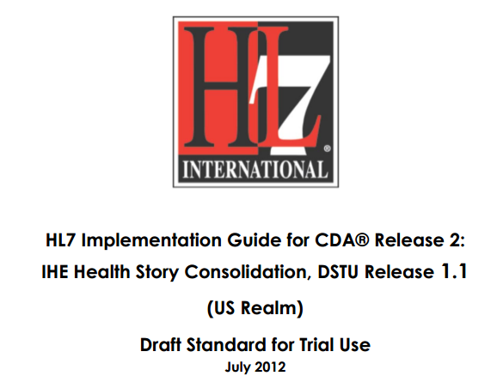
In v3 CDA…”text-based”

Slide 30
Conformance Resources
In FHIR, all conformance resources are in computable form
Share in a registry
Query to find relevant resources
At design time or at runtime
Subscribe to monitor changes
Compare with instances created by others and see where the mismatches are
How well will these systems interoperate?
Code generation

Slide 31
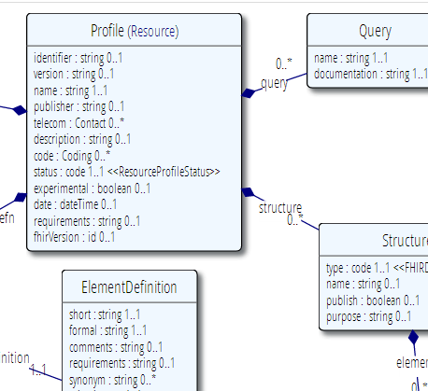







Publish!
Find & maintain
http://simplifier.net
http://registry.fhir.org
Retrieve & use
Notes:
A profile can be published on a FHIR (based) server (it’s a Resource, after all)
On Registry: http://simplifier.net
Or in a version-management system, or by e-mail, or…
As long as people can *find* them, because publishing your profile should help others to find & adhere to it.

Slide 32
Tooling
Tooling infrastructure is progressing past early stages
Have some tools for profiles, value sets, capability statements
Tooling is still “early” in the maturity process
Some alpha, some beta, a few are getting to the “robust” stage
As artifacts get locked down as ‘normative’, tool environment will further mature
Registries are in a similar state
Feedback (and new tools) welcome

Slide 33
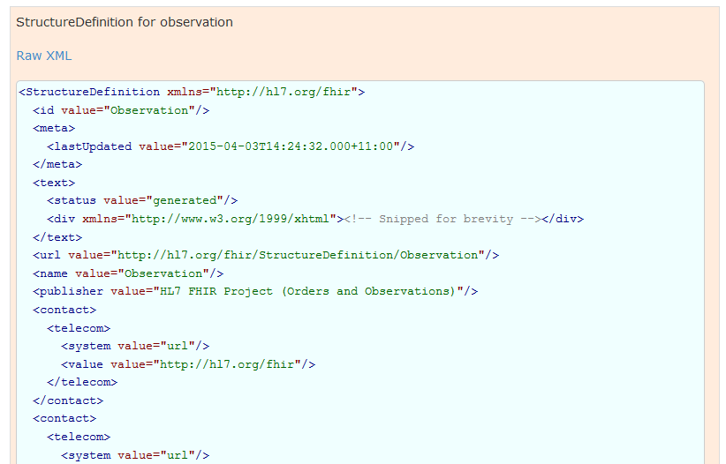
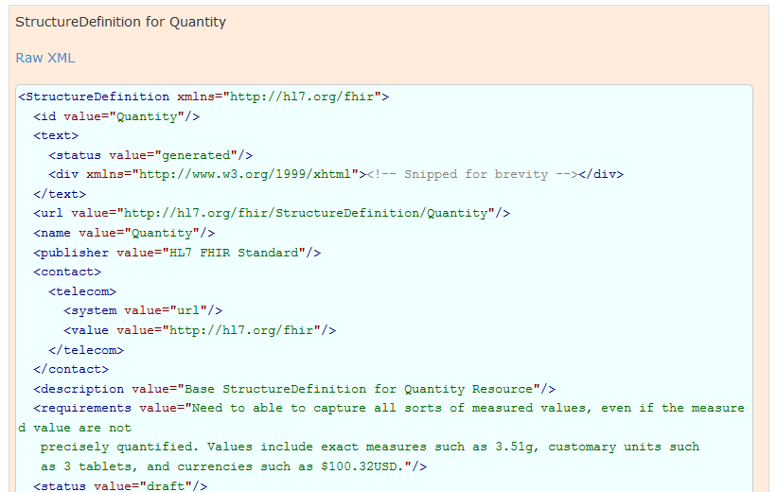
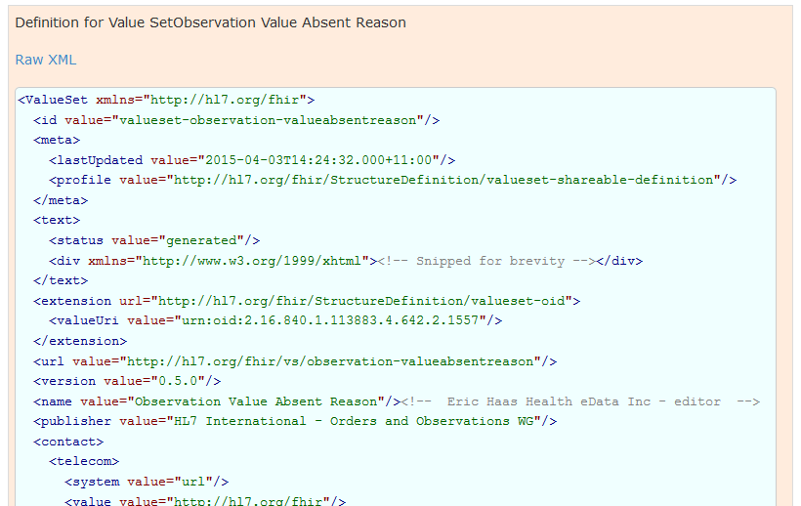
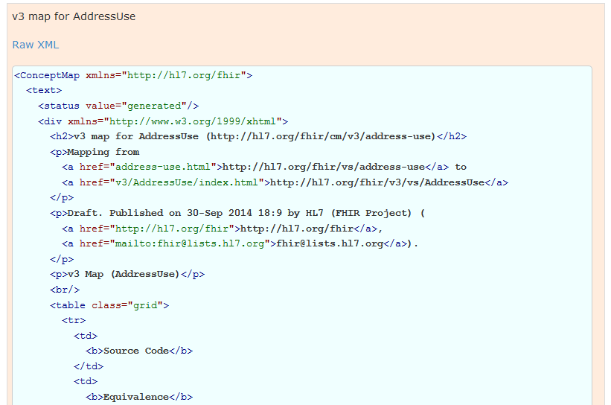
Used in the core spec
For implementer convenience, the specification itself publishes its base definitions using these same resources!
Notes:
See next slide for HTML rendering of these XML structures…

Slide 34
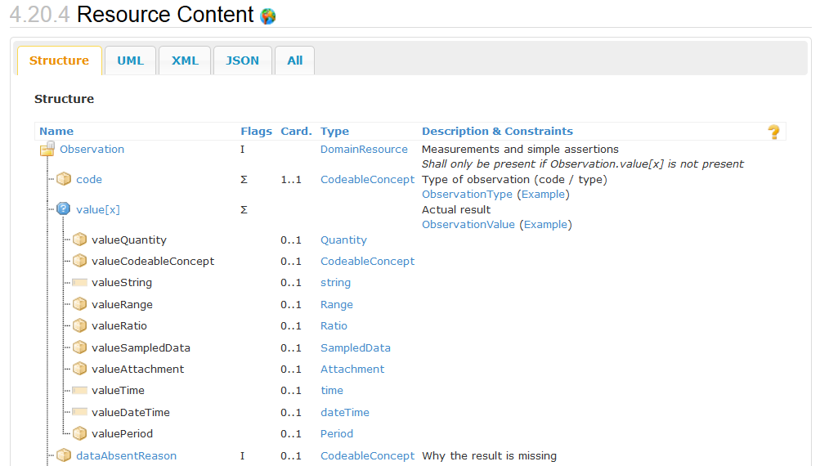
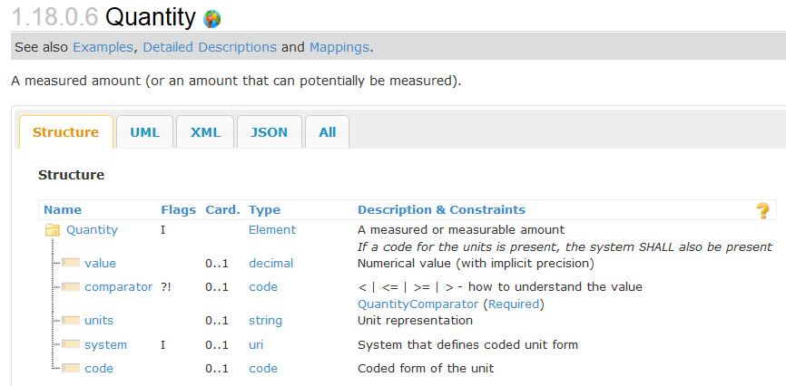
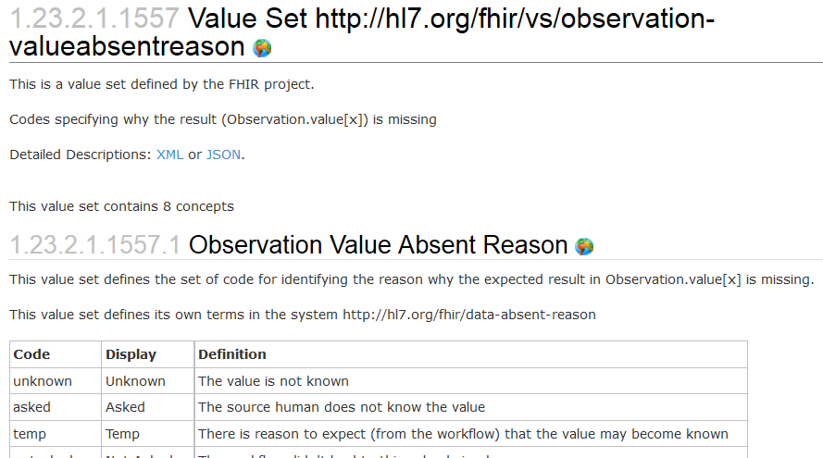
Resources in the core spec
Published specification is generated from those same computable representations
Let’s take a look:
http://hl7.org/fhir

Slide 35
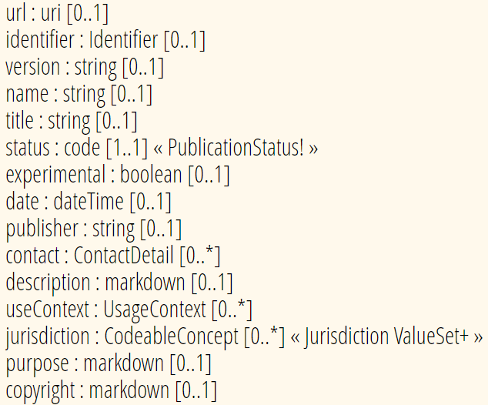
Conformance Metadata
Common across most conformance resources
Supports
Identification
Registration/discovery

Slide 36
Identifying conformance resources
id – Unique to the server the resource is stored on
Conformance resources will be copied many places
Therefore – id is not reliable
url – Canonical URL – consistent across servers
This is how all conformance resources are referenced
version – “business” version – represents a released version
Canonical URL stays the same across versions
identifier – “business” identifier
E.g. OID. Not commonly used

Slide 37
Canonical references
References can be version-specific or version-independent
http://hl7.org/fhir/us/core/StructureDefinition/us-core-procedure
Any version of us-core-procedure
http://hl7.org/fhir/us/core/StructureDefinition/us-core-procedure|1.0.1
US Core as based on FHIR R3

Slide 38
Versioning…
A “version” – author assigned
What if you change something after publishing?
Just a typo? Change of definition?
Make something optional that wasn’t?
Make something mandatory that was optional?
Add an extension?

Slide 39
“Non-breaking change”?
If old data can still be:
Validated against the new profile
Correctly interpreted against the new profile
This can only be determined by the profile’s authors (and even depends on the way it is used)
Notes:
* E.g. changing the order of questions may in some context considered breaking interpretation, while in others it is not.

Slide 40
Rules for breaking changes?
There are none (so far)
Common practice:
While artifacts are considered “Draft” (e.g. STU status), breaking changes are allowed
Once artifacts are “final” (e.g. Normative status), breaking changes force the creation of new artifacts
You’ll need to define your own policy
Make sure you know the policy for artifacts you reference
Consider version-specific references

Slide 41
HL7’s base inter-version rules
http://hl7.org/fhir/versions.html#change

Slide 42
Profiling Terminology
Notes:
Time start-10:00 (10 minutes)

Slide 43
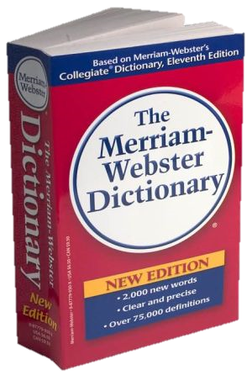
CodeSystem vs. ValueSet
“Dante’s deadly sins”
Pride
Envy
Wrath
Sloth
Avarice
Gluttony
Lust
Takes concepts from…
Definition of terms
An enumeration of terms
“Code System”
“ValueSet”
Example: SNOMED-CT
Example: “Childhood diseases”

Slide 44

“Special” cases
No need to write them all down!
Takes concepts from…
“All words under B”
“All words in the
Merriam-Webster dictionary”
“Words for ‘nerd’”
Bookworm
Geek
Grind
Weenie
Wonk
Dink (slang)
Dork (slang)
Swot (slang)
Takes concepts from…
Takes concepts from…
Can take concepts from multiple coding systems!

Slide 45
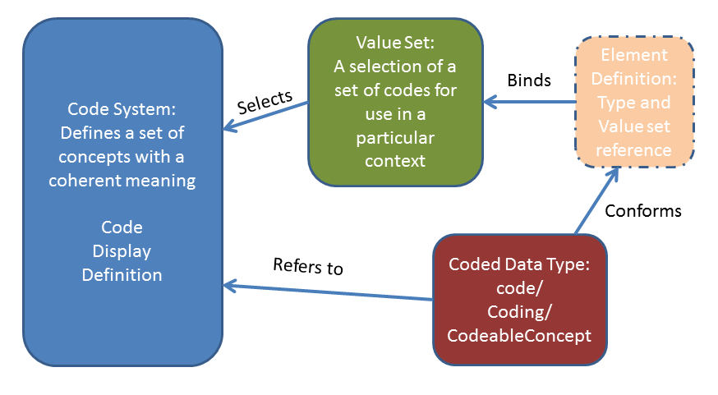
Defining terminology

Slide 46
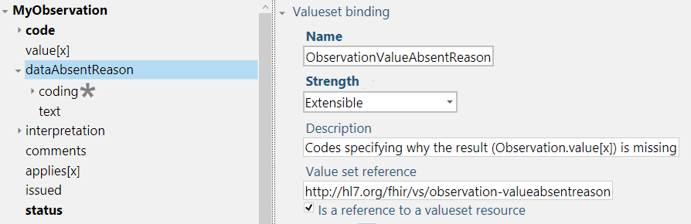
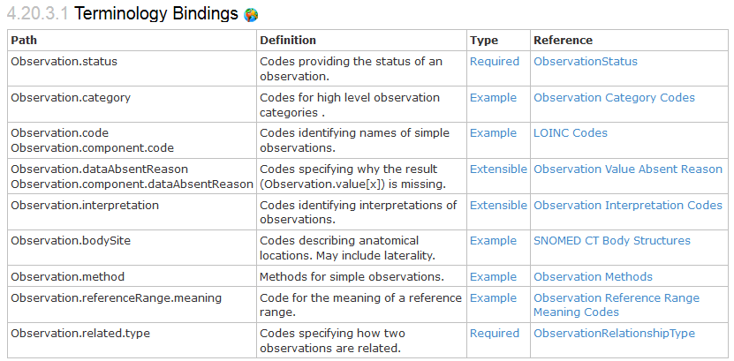
Bindings
When used in a Resource, the modelers include Bindings
Bindings specify which codes can be used
Notes:
Examples is from http://hl7.org/implement/standards/fhir/2015May/observation.html

Slide 47
Binding Strength
required: You must use the specified codes
Or omit the element if no code applies for the concept
extensible: You must use the specified codes if they apply
Free to use other codes or text if the value set doesn’t cover the concept
preferred: You SHOULD use the specified codes
But if you have a good reason, you can use something else instead – it is not required to use the specified codes in order to be conformant
example: These codes just give an idea of what you might use
No expectation (or recommendation) of use

Slide 48
Profiling Terminology
Tighten the binding strength (e.g. Extensible -> Required)
Change the value set
required: Constrain allowed codes
e.g. male/female/other/unknown -> male/female
extensible: May constrain and add concepts not covered by existing codes
preferred, example: Can pick whatever codes you like
But should ideally be able to map to/from preferred codes
You can propose changes to code systems and value sets owned by others
Can define codes in your own code system
Notes:
Two aspects: whether you as a profile author can change the valueset and
Whether the user of your profile can provide codes from other valuesets in an instance
Fhir defines offical extensions for special binding constraints: elementdefinition-maxValueSet and elementdefinition-minValueSet
List: http://hl7-fhir.github.io/elementdefinition-extensions.html
http://hl7-fhir.github.io/extension-elementdefinition-minvalueset.html - The minimum allowable value set, for use when the binding strength is 'required' or 'extensible'.
http://hl7-fhir.github.io/extension-elementdefinition-maxvalueset.html - The maximum allowable value set, for use when the binding strength is 'extensible'.
Also see issue 9185: http://gforge.hl7.org/gf/project/fhir/tracker/?action=TrackerItemEdit&tracker_item_id=9195&start=0

Slide 49
ValueSet Tooling
Grahame
http://www.healthintersections.com.au/FhirServer
ClinFHIR.com
CodeSystem Builder, ValueSet Explorer
Snapper
http://ontoserver.csiro.au/snapper2-dev/
Apelon
http://www.apelon.com/
Notes:
Snapper doesn’t do ‘nesting’ of codes

Slide 50
Terminology Exercise 1
Create a code system with these colors:
Red, Blue, Green, Yellow, Amber, Turquoise
Bonus points
Provide definitions for your codes
Include relationships
Include RGB values

Slide 51
Terminology Exercise 1 - Review
Were your codes words, numbers or letters?
Were your codes upper-case, lower-case or mixed case?
Is turquoise blue, green, both or neither?
How do you “define” a color?
How did you choose your URL?
What other relationships or properties could we have defined?
Note that the JSON wasn’t in order?
Also, Snapper doesn’t allow nested codes – thoughts on why?
Any other challenges, questions or insights?

Slide 52
Terminology Exercise 2
Create a ValueSet containing all the codes from your code system

Slide 53
Terminology Exercise 2 - Review
Did you enumerate all the codes or define an expression?
When you’re creating an IG, when might you want to do one or the other?
Did anyone limit their reference to the code system to a single version of the code system?

Slide 54
Terminology Exercise 3
Define a new value set based on the first value set that includes the following codes:
Red, Blue, Emerald Green, White, Black
Mental exercise only – how would you do it?
(jot down your steps)

Slide 55
Terminology Exercise 3 - Review
How do you exclude the codes you don’t want?
Where should you put the new codes you do want?
Did you think about creating a relationship from Emerald Green to green?
If you use words for your codes, did you put a space in “emerald green”?
If the base profile was bound to value set 1, what binding strengths would allow you to substitute value set 2 in a derived profile?

Slide 56
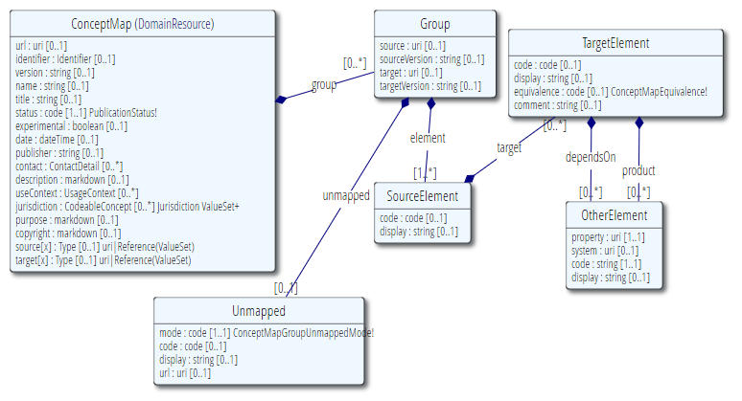
ConceptMap
Define mapping
From one set of concepts to one or more other concept(s)
Notes:
http://hl7.org/implement/standards/fhir/conceptmap-example-specimen-type.html
v2 table 0487 => SNOMED-CT

Slide 57
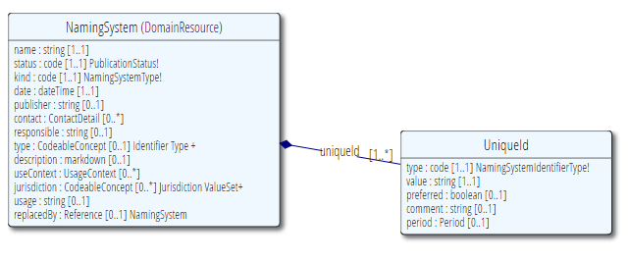
NamingSystem
What’s the URL for Michigan Podiatrist License Number?
New South Wales Driver’s License Number?
When converting between FHIR and CDA, how to I find the OID for this URL (or vice versa)
Notes:
Known Code Systems
http://hl7.org/implement/standards/fhir/terminologies-systems.html
Example: http://hl7.org/implement/standards/fhir/namingsystem-registry.html
id: us-ssn
name: United States Social Security Number
What tools would you use?

Slide 58
Discovering codes
https://browser.ihtsdotools.org
https://loinc.org
https://terminology.hl7.org
Notes:
Licensing considerations
What version of SNOMED?
Search for “Black”

Slide 59
Discussion
Good/best practices for terminology in IGs?
Local vs. shared terminologies?
Meaningless vs. meaningful codes?
One code system vs. many?
Flat vs. hierarchical?
Enumerated vs. algorithmic value sets?

Slide 60
We haven’t covered everything
What are ‘good’ definitions?
Managing concept overlap
Terminology maintenance strategies
Code system supplements
Terminology services
Impact of terminology validation on performance
Setting expectations for terminology ‘currency’
Etc.

Slide 61
Profiling Structures

Slide 62
Profile Uses
Why profile structures?
Define content for documents and messages
Define extensions
Set interoperability expectations in a particular context
National standards, types of care, business patterns
Clinical practice guidelines / detailed clinical models
Document system capabilities

Slide 63
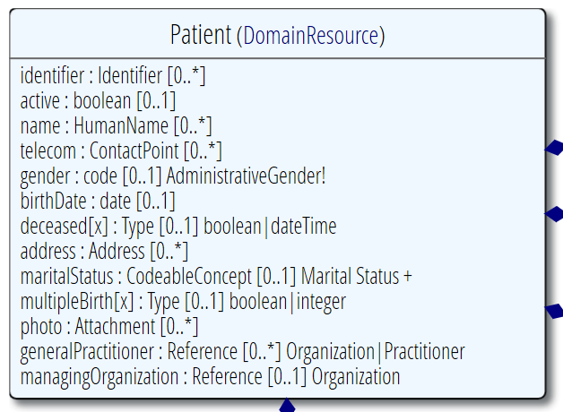
Profiling a resource
Demand that the identifier uses your national patient identifier
Limit names to just 1 (instead of 0..*)
Limit maritalStatus to another set of codes that extends the one from HL7 international
Add an extension to support “RaceCode”
Note: hardly any mandatory elements in the core spec!

Slide 64
Uses for profiles
Server & client may publish and check their conformance to a profile
Validating instances, messages
Implement "FHIR spec-like" website from Profiles as part of an Implementation Guide
Code generation
Dynamic UI Generation

Slide 65
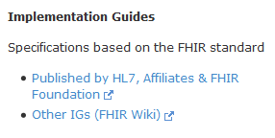
Examples…
Let’s look at US Core Profiles
http://hl7.org/fhir/
Implementation Guides
http://www.fhir.org/guides/registry
Simplifier
https://simplifier.net/ui/ig/SIG
Notes:
Visit http://hl7.org/implement/standards/fhir/daf/daf.html
http://hl7.org/fhir => Implementation Guides => DAF
Example: DAF Patient - http://hl7.org/implement/standards/fhir/daf/daf-patient.html

Slide 66

Referring to a profile
Observation
Cholesterol
6.3 mmol/L
High
(recommended 4.5)
http://acme.org/
http://acme.org/StructureDefinition/LDLCholesterol
Metadata “Lipid Profile” v1.0.0 Draft
urn:acme.org:lipid-profile:v1
Author: e.kramer@furore.com
I’m conforming to (meta.profile=)
http://acme.org/StructureDefinition/LDLCholesterol
Structure “cholesterol”
Notes:
* You can formalize these constraining statements into a Profile Structure called ‘cholesterol’
* An Observation instance may use a Tag to assess conformance to that structure
* Validators check the contents of the instance against these constraints.
DSTU-2: Resource.Meta.profile (uri)
http://hl7.org/implement/standards/fhir/2015May/resource.html#Meta

Slide 67
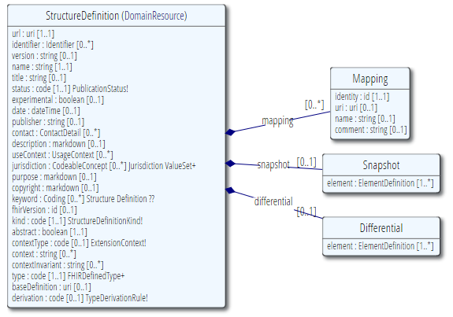
StructureDefinition
Defines data structures
Core resources
Core datatypes
Constraints on resources & datatypes
i.e. “profiles”
Extensions
Logical Models

Slide 68
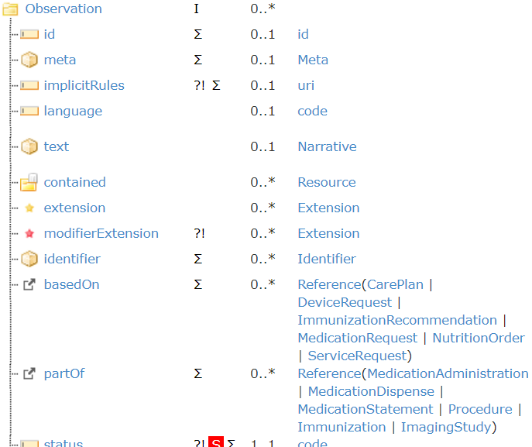
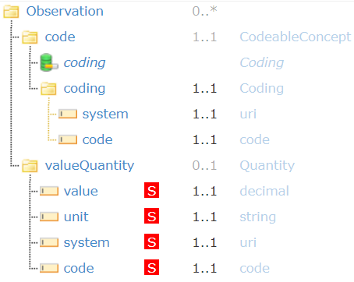
Snapshot vs. Differential

Slide 69
Snapshot vs. Differential
Differential
What’s changed from the base resource?
Added elements
Constrained elements
Only lists what’s different
Snapshot
What happens when you apply those differences to the snapshot of the parent model

Slide 70
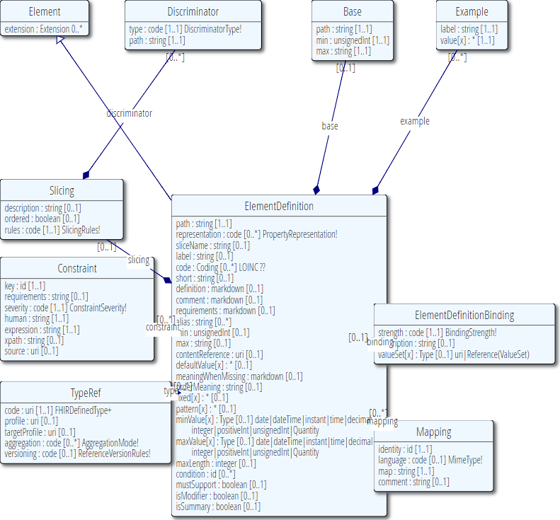
ElementDefinition
Describes every node in a data type, resource or logical model
Name, data type, cardinality, binding, definition, constraints, mappings, …

Slide 71
Must support?
Distinct from cardinality (what must be in instance)
Authors: SHALL be capable of providing a value for the element
Consumers: SHALL be capable of extracting and doing something useful with the element.
"Something useful" is context dependent. The profile or implementation guide SHALL describe what it means for applications to “support” the element
Notes:
Note: the spec *never* sets this to true, since it’s context dependent.
MustSupport is defined on element level
Cf. IsModifier: defined on structure level

Slide 72
Contextualize narrative
Override the base spec’s descriptions by adding context specific narrative:
short : string 1..1
formal : string 1..1
comments : string 0..1
requirements : string 0..1
synonym : string 0..*
example[x] : 0..1 (example value!)
mappings : 0..* (more specific mappings)

Slide 73
Aggregation
Aggregation: for each ResourceReference choose 1..3:
Code | Definition
Contained | Reference to a contained resource.
referenced | Reference to a resource that has to be resolved externally
..bundled | Reference points to will be found in the same bundle

Slide 74
Profiling “wisely”
Don’t constrain out elements unless they’re a genuine error
Patient can only have one name X
Patient can’t be deceased ✔
If you need to limit repetitions, instead slice and define what you want, possibly with extensions
Patient must have one name with use code of ‘legal’, jurisdiction of U.S. (extension?), and no end date
Patient must have one phone number with “lab call-back” extension

Slide 75
Authoring a FHIR Profile
Excel (build tool)
We’re trying to move away from this
Forge: FHIR-specific profiling tool
https://simplifier.net/forge
Lantana Trifolia Workbench
https://trifolia-fhir.lantanagroup.com
MDHT: UML Based modelling tool
https://projects.eclipse.org/projects/modeling.mdht
By hand, raw JSON or XML (for the brave/experts)
Generate from code
Notes:
Excel: FHIR Spec\v1.01\fhir-spec\site\uslab\patient-uslab-review.xls
MDHT: https://projects.eclipse.org/proposals/model-driven-health-tools, https://projects.eclipse.org/projects/modeling.mdht
Forge: Create a new Observation profile

Slide 76
Exercise 4 – authoring a profile
Let’s get set up with Trifolia

Slide 77
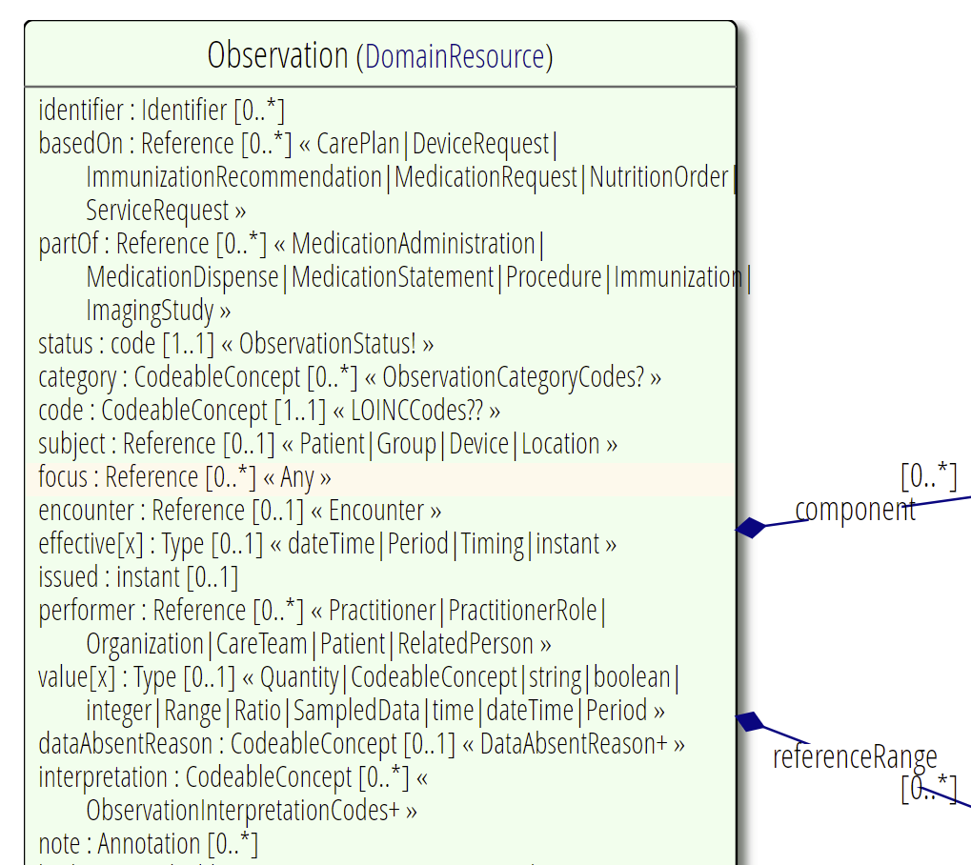

Exercise 4 – authoring a profile

Slide 78
Exercise 4: Authoring a profile
completed
Required binding
1..1

Slide 79
Exercise 4 – authoring a profile - review
Discussion?

Slide 80
Formal constraints
Notes:
Time start-10:00 (10 minutes)

Slide 81
Formal constraints
…beyond cardinalities and bindings, there are a lot of other conditions you might want to formulate:
“If a Cholesterol value result is not available, use the comments field”
“A patient’s birthdate must be on or before today’s date”
These may concern a single element or cover multiple elements.

Slide 82
Formal constraints
Uses free text (human) + FHIRPath (executable)
Constraints should be declared on lowest element in the hierarchy that is common to all nodes referenced by the constraint.
Identified by (local) ‘Key’, involved elements refer to that id
Specify severity (“error”, “warning”, “best practice”)

Slide 83
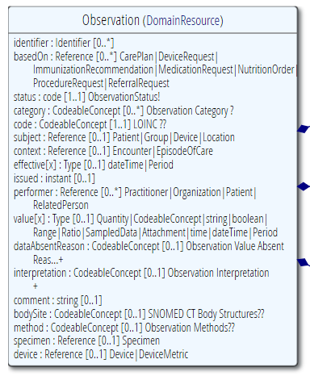
Context of the constraint
“If a Cholesterol value result is not available, use the comments field”
This constraint is on the elements “valueQuantity” and “comments”
We would have to formulate this constraint on the Observation, this is the context of the constraint
We assign the constraint a “key” value that’s unique within the Observations’ constraints
We refer from both “value[x]” and “comments” to this “key”. This means: if my value changes -> revalidate the constraint

Slide 84
Why FHIRPath
Need to enforce constraints in all syntaxes
XML, JSON, RDF, more?
XPath 1.0 is too limited, XPath 2.0 isn’t supported in a number of key languages
Wanted a path language that was terminology aware

Slide 85
FHIRPath vs. XPath
FhirPath
uniqueId.where(preferred = true).distinct(type)
Xpath
not(exists(for $type in distinct-values(f:uniqueId/f:type/@value) return if (count(f:uniqueId[f:type/@value=$type and f:preferred/@value=true()])&gt;1) then $type else ()))

Slide 86
FHIRPath applications
Invariants in ElementDefinition
Slicing discriminator
Search parameter paths
Error message locations in OperationOutcome
URL templates in Smart on FHIR's CDS hooks
PATCH
Testing scenario payload evaluation

Slide 87
FHIRPath syntax
Syntax & formal grammar:
http://hl7.org/fhirpath/
https://github.com/ewoutkramer/fhirpath/blob/master/fluentpath.md
Resembles .NET LINQ / Java query expressions
Example:
Patient.identifier.where(use=‘official’)
Patient.extension(‘…url…’)

Slide 88
FHIRPath basics
To drill deeper into the tree, specify the element name
E.g. Patient.contact.name.type.coding.code.extension
To traverse from Reference/canonical to referenced thing, use ‘resolve()’
E.g. Patient.generalPractitioner.resolve().name
Result is always a ‘collection’ of matching elements
Above would be all names for all generalPractitioners
Represent polymorphic types without [x] (or suffix)
Observation.value Observation.value[x] Observation.valueCode

Slide 89
FHIRPath navigation
{
"resourceType": "Bundle",
"entry": {
"resource": {
"resourceType": "Patient",
"name": [{
"type": {
"coding": [{
"system": "...",
"code": "test“
}, {
"system": "...",
"code": "test2“
}]
}
}]
If ‘name’ has context:
%root
%resource
$this
type
type.coding.code

Slide 90
Common FHIRPath functions
.count()
.where([some filter])
.not()
.extension('url') short for .extension.where(url='url')
.exists() short for .count()!=0
.empty() short for .count()=0 or .exists().not()

Slide 91
Common FHIRPath operations
All standard math, comparison & logic operations
+ - / * < > = != <= >= or and xor
‘is’ check’s type
E.g. %foo is Patient
‘as’ performs type conversion
E.g. Observation.value as Quantity
‘implies’ gives conditional assertion
E.g. (value is Quantity).not() implies

Slide 92
Exercise 5: Write some FHIRPaths
MedicationRequest.dispenseRequest.quantity
Value must be between 10 and 90
Patient
Number of patient telecoms + addresses can’t exceed 5
Observation
If value is a Quantity, reference range is required
Coding
Either “text” or at least one coding display must be specified

Slide 93
Exercise 5: Write some FHIRPaths - Review
MedicationRequest.dispenseRequest.quantity
value>=10 and value<=90
Patient
telecom.count + address.count <= 5
Observation
value is Quantity implies referenceRange.exists()
Coding
text.exists() or coding.display.exists()

Slide 94
FhirPath tools
Nicolai http://niquola.github.io/fhirpath-demo/#/
Brian Postlethwaite https://github.com/brianpos/FhirPathTester
Notepad++ plugin by Grahame http://www.healthintersections.com.au/FhirServer/fhirnpp.htm
Simplifier connector

Slide 95
FhirPath libraries
Reference implementations:
.NET
Java
Delphi
JavaScript

Slide 96
Hints
Some constraints can be handled other ways
slicing
Cardinality
Look at examples in the spec and copy/modify
If you can’t figure out how to make it work:
http://chat.fhir.org

Slide 97
Slicing
Notes:
Time start-10:00 (10 minutes)

Slide 98
When to use slicing?
One element, different sets of rules
E.g.
If Observation.value is “Quantity”, binding is “myFavoriteUnits”; If Observation.value is “CodebleConcept”, binding is “SnomedStuff”
There must be exactly one “legal” name (but having other names is fine)
ServiceRequest.

Slide 99
Slicing into a CCD
Composition
type = “34133-9” “Summarization of
episode note”
Section
code = 42348-3 (“Advance directives”)
Section
code =11450-4 (“Problem list”)
…
Section
code = 18776-5 (“Treatment plan”)
“Slice” the repeating sections into a fixed set of profiled sections.
“code” is fixed and is called the discriminator

Slide 100
Slicing is allowed when:
Element repeats (i.e. max cardinality > 1)
Element is polymorphic (i.e. element name is foo[x])
NOT allowed (yet?) for non-repeating, single-type elements

Slide 101
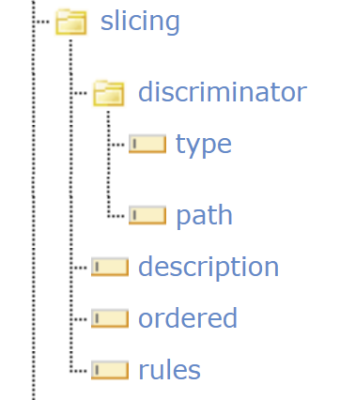
Triggering slicing
Discriminator:
How do you decide which set of rules applies?
“First look at name.type, then look at name.period.end”

Slide 102
Discriminator types
Type
Each slice must have a distinct data type
Only type of slicing allowed non-repeating polymorphic elements
Value/Pattern
Slices must declare fixed value, pattern or required ValueSet bindings
E.g. “Rule 1 applies when Composition.section.code=A”

Slide 103
Pattern
Declared pattern (CodeableConcept)
Matching instance
{ "coding": [{ "system": "foo",
"code": "bar"
}]
}
{
"coding": [{
"system": "something",
"code": "else"
"display": "a label"
}, {
"system": "foo",
"code": "bar"
"display": "whatever"
},
"text"
}
Notes:
Specify multiple values at once
Avoid drilling down unnecessarily
Don’t constrain stuff you don’t need to

Slide 104
Discriminator types (cont’d)
Exists
Max of two slices – one must have min>0, one must have max=0
E.g. “One set of rules for names that have type.coding, a different set of rules for those that don’t”
Profile
Each slice must have a single type with a distinct profile or targetProfile (Reference and canonical only)
NOTE: Profiles must all be mutually exclusive
This can be expensive to validate

Slide 105
Discriminator values
Expressed as simplified FHIRPath
$this
Simple paths (e.g. contact.name)
.extension('foo')
.resolve()
.ofType('sometype')

Slide 106
Multiple discriminators
Sometimes you need to look at more than one element to decide the rules
E.g. Must look at both ‘system’ and ‘code’
(Though pattern makes this requirement less common)

Slide 107
Exercise 6: What discriminator & slice constraint?
“Patient contacts that are emergency contacts or next of kin must have name and phone number. Others need only have phone number”
“If effective[x] is ‘Period’, Period.start is mandatory”
Practitioner can only have one phone number flagged as “after hours”
“Patient must have exactly one non-expired legal name”
“Practitioner must have name or phone number”

Slide 108
Exercise 6: Discriminators – example
“Patient contacts that are emergency contacts or next of kin must have name and phone number. Others need only have phone number”
Slicing on: [what element?]
Discriminator path: [what FHIRPath?]
Discriminator type: [value|pattern|type|profile?]
Constraint: [What constraint must exist at that path?]

Slide 109
Exercise 6: Discriminators – review - 1
“Patient contacts that are emergency contacts or next of kin must have name and phone number. Others need only have phone number”
Slicing on: Patient.contact
Discriminator path: relationship
Discriminator type: value
Constraint: required valueset binding
Valueset contains “C” and “N” codes

Slide 110
Exercise 6: Discriminators – review - 2
“If Observation effective[x] is ‘Period’, Period.start is mandatory”
Slicing on: Observation.effective[x]
Discriminator path: $this
Discriminator type: type
Constraint: type.code set to 'Period'

Slide 111
Exercise 6: Discriminators – review - 3
Practitioner can only have one phone number flagged as “after hours”
Slicing on: Patient.telecom
Discriminator path: telecom.extension('after-hours')
Discriminator type: exists
Constraint:
Patient.telecom.extension:after-hours is 1..1

Slide 112
Exercise 6: Discriminators – review - 4
“Patient must have exactly one non-expired legal name”
Slicing on: Patient.name
Discriminator path 1: type
Discriminator type 1: value
Discriminator path 2: period.end
Discriminator type 2: exists
Constraint:
type fixed value of code, period.end max=0

Slide 113
Exercise 6: Discriminators – review - 5
“Practitioner must have name or phone number”
Trick question: can’t slice across elements and can’t slice an overall resource
Handle this one as an invariant
Name.exists() or telecom.where(system='phone').exists()

Slide 114
No discriminator?
Discriminator is optional
Specify the way to choose what rule applies in ‘free text’
Non-computable
Very rare
Can also use description with discriminator (documentation)

Slide 115
Ordered slices
Only appropriate if element has defined “elementOrderMeaning” (e.g. HumanName.given)
If set to true, means slices must appear in that order.

Slide 116
Open vs. closed
Open – list of “rule sets” isn’t exhaustive – it’s ok if there are repetitions that don’t meet these rules
Closed – all repetitions must meet one of these rules – use with caution
Open-at-end – Extra repetitions must be after those defined. Generally, not appropriate.

Slide 117
extensions
Notes:
Time start-10:00 (10 minutes)

Slide 118
Extensions
Accommodate those elements not supported by 80% of systems
Note - You’re not extending a resource per se, but you specify where an extension may occur:
A specific element within a resource (even root)
A specific element within a data type
All elements referencing a data type
All elements mapping to a specific mapping target
An extension

Slide 119
Extension Context
An extension has a context type
Resource, Datatype, Extension, Mapping
And a context path
(Resource) Observation
“The observation was calculated”
(Resource) Observation.value
“The observation’s ‘value’ was calculated”
(Datatype) Quantity
“This quantity was calculated” (any Quantity used in any resource!)

Slide 120
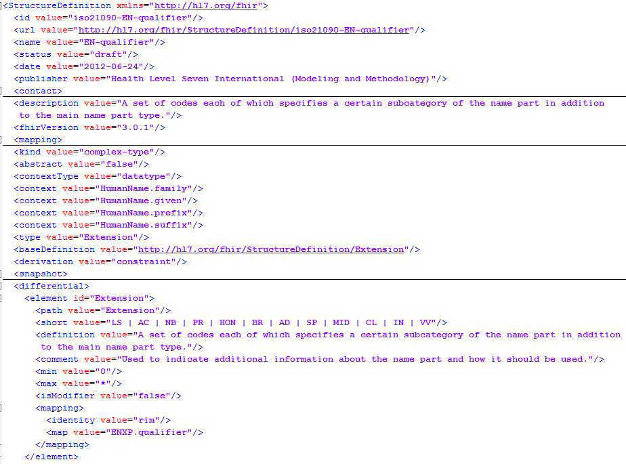
Extension Definition
Support multiple contexts!

Slide 121
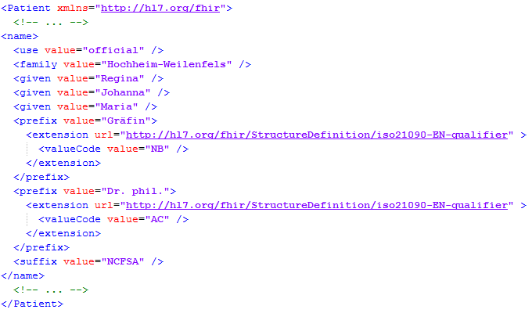
Extending a name
Key = location of formal definition
Value = value according to definition
Notes:
http://hl7.org/implement/standards/fhir/2015May/name-part-qualifier.html
NB = Nobility
AC = Academic

Slide 122
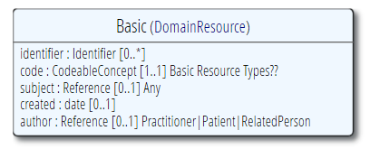
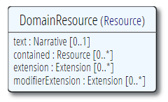
The “Basic” resource
Now, what if you have the need for a completely “new” resource?
…then add extensions for each element

Slide 123
Exercise 7 – create an extension
Define the “after-hours” extension
Boolean that is ‘true’ if a telecom is to be used ‘after-hours’
Add an optional reference to that extension to your profile

Slide 124
Exercise – create an extension - review
Did you enforce the cardinality as 0..1 in the definition?
How will you ensure the extension is resolvable?
CodeableConcept vs. Coding vs. code vs. Boolean

Slide 125
Logical Models
Notes:
Time start-10:00 (10 minutes)

Slide 126
Logical Models
“Tree of data that has no particular use in the FHIR exchange paradigms.”
Typically used to represent ad-hoc combinations of FHIR data for packaging convenience
And/or content models as defined by other specifications (e.g. CDA, CIMI, openEHR).

Slide 127
Logical Models
Logical Models may use normal FHIR data types - or even resources
Have the full suite of the FHIR definitional framework to call on (e.g. terminology definitions/service, mapping language, etc).

Slide 128
Logical Models
FHIR Logical Models are found in the Workflow Patterns:
Request
http://hl7.org/fhir/workflow.html#request
Event
http://hl7.org/fhir/workflow.html#event
Definition
http://hl7.org/fhir/workflow.html#definition

Slide 129
Implementation guides
Notes:
Time start-10:00 (10 minutes)

Slide 130
Different Kinds
Strategy
National scope guide
Principles
Overarching principles
Subject
Subject with multiple usecases
Usecase
Single usecase
e.g. medication process
e.g. prescription
e.g. basic components
e.g. infrastructure, security

Slide 131
Typical Content
Title
Table of contents
Document information
Introduction to the guide
Principles & background
Functional requirements and high-level use cases
Design considerations
Package contents (= use case?)
Privacy and security guidance
Testing and certification
Appendix
List of all artifacts used in this guide
Notes:
Best practices, guidelines, default template
Recommended, not mandatory
Proposed template: http://implementationguidetemplate.azurewebsites.net/
Example: https://simplifier.net/ui/ig/SIG

Slide 132
Examples
US Core
http://hl7.org/fhir/us/core/index.html
C-CDA on FHIR
http://build.fhir.org/ig/HL7/ccda-on-fhir-r4
Da Vinci - Coverage Requirements Discovery
http://build.fhir.org/ig/HL7/davinci-crd/index.html
International Patient Summary
https://build.fhir.org/ig/HL7/fhir-ips

Slide 133

Implementation Guide Resource
Define content structure
References to external artifacts
Page content files
Images, CSS, JavaScript
Supported page formats:
Markdown
HTML

Slide 134
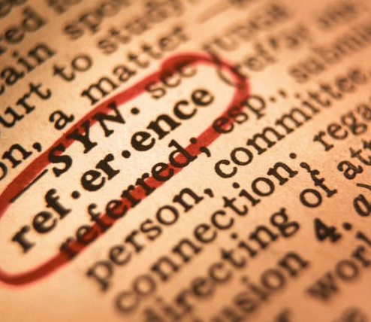
Implementation Guide Resource
Define conformance package(s)
Set of conceptually related artifacts
Based on FHIR NPM package
Specify references to external artifacts
StructureDefinition
OperationDefinition
SearchParameter
ValueSet
Example resources

Slide 135
Implementation Guides & Package
Implementation Guide
Provides human-readable information (narrative)
Contains formatted text, pictures, attachments, …
Explains to developers how to implement a specific use case
Publish to local/online website or to PDF
Package
Provides machine-readable information (computable)
Contains conformance resources
Allows machines to validate, generate code, generate UI, …
Publish to FHIR Package server

Slide 136
Authoring Implementation Guides
IG Builder
Official HL7 open source command-line tool
Can render IG resource as a website

Slide 137
Authoring Implementation Guides
Simplifier
Browse & find published IGs
Supports online IG authoring & publication
Embed rendered artifacts
Templates allow you to adjust look & feel

Slide 138

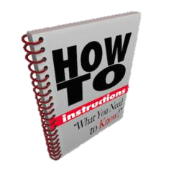
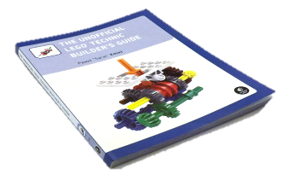
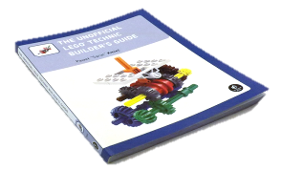



Publish!
Guide
Author & Store
Publish
http://simplifier.net
http://registry.fhir.org
Implement
Test & Verify
Notes:
Authoring workflow ⬄ Publishing workflow

Slide 139
Other Conformance Resources
Notes:
Time start-10:00 (10 minutes)

Slide 140
OperationDefinition
Describes additional operations over and above the RESTful interactions defined in the specification
RPC calls with FHIR
What is the name?
Input/output parameters
What does it do?
Works on which resources?
Notes:
Example: http://hl7.org/implement/standards/fhir/operation-valueset-validate-code.html
ValueSet validation

Slide 141
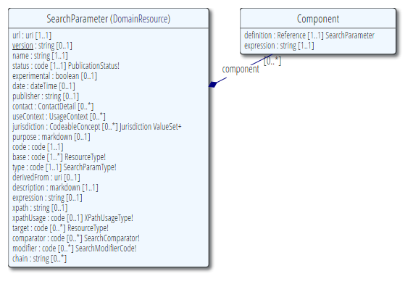
SearchParameter
Extend/restrict searches
Describes additional searches to filter resources
What is the name?
Elements filtered
Resource the search works on
Notes:
Note: better resource name would be “SearchParameterDefinition”
Example: HelseNord REKVIRENT extension

Slide 142
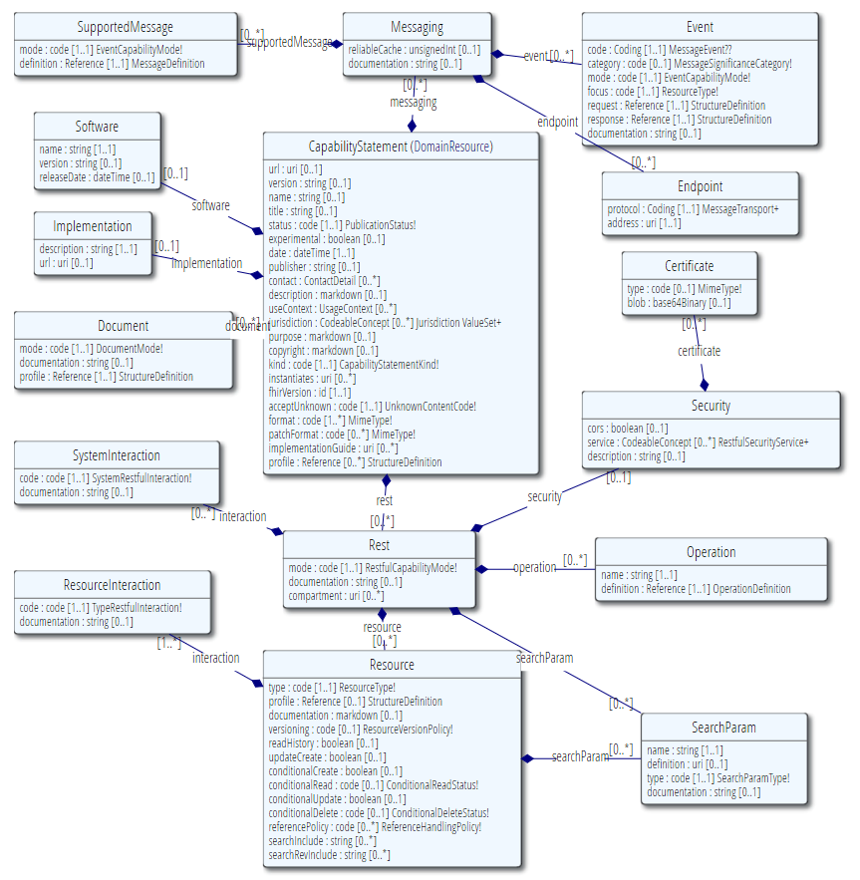
CapabilityStatement
A set of capabilities of a FHIR Server
Binds all conformance resources together
Large beast…
Notes:
Note: better resource name would be “SearchParameterDefinition”

Slide 143
CapabilityStatement
Describes how a client or server uses or should use the FHIR API
Which wire formats supported?
Which resources?
Which operations supported?
Which profiles supported?
Is this a test server?
What’s the name of the software?
Notes:
Note 1: API performs an (optional) version check on the first call
Note 2: Conformance resource for a fully fledged FHIR server can be quite large, e.g. 1.5MB

Slide 144
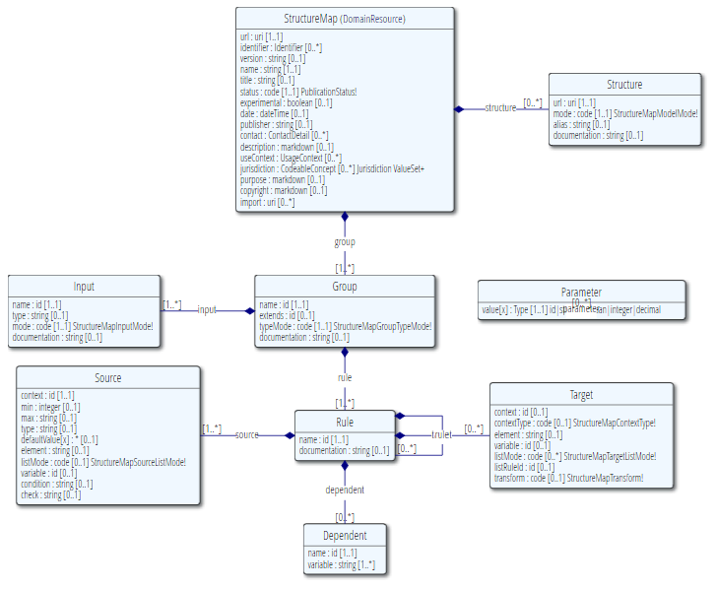
StructureMap

Slide 145
FHIR Mapping Language
Addresses 2 very different kinds of transformations:
Structural changes between the source and target structures
Differences in formats in string (and related) primitives contained within the structures

Slide 146
Registries
Notes:
Time start-10:00 (10 minutes)

Slide 147
Official HL7 FHIR registries
HL7 FHIR Profile registry
https://registry.fhir.org/
Find official profiles published by HL7 intl. & WGs
HL7 FHIR Implementation Guide registry
http://www.fhir.org/guides/registry
Browse official HL7 implementation guides

Slide 148


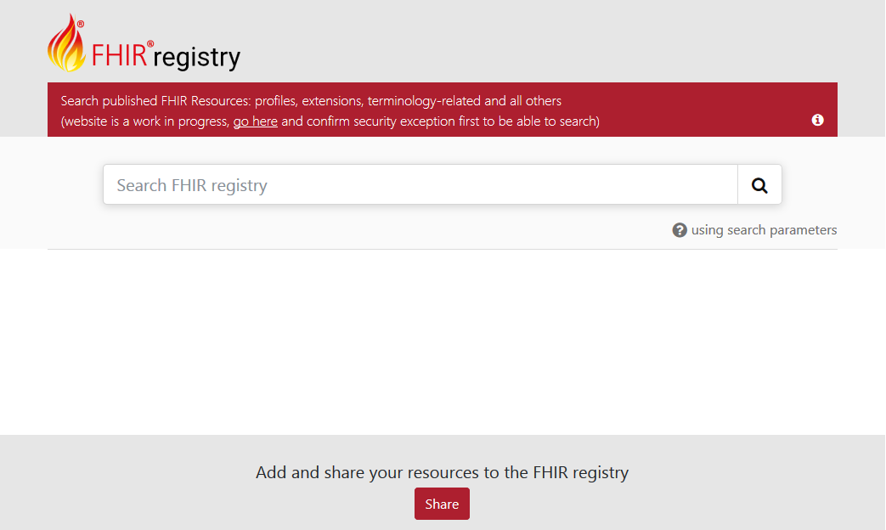

Registry.fhir.org
Powered by

Slide 149
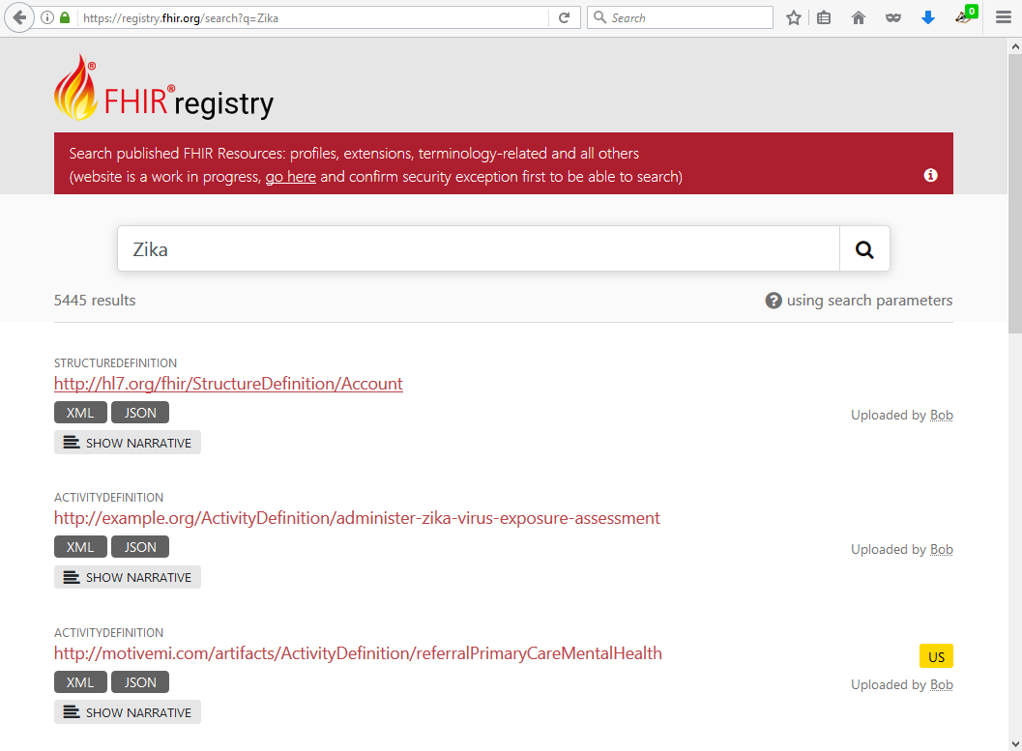
Registry.fhir.org

Slide 150
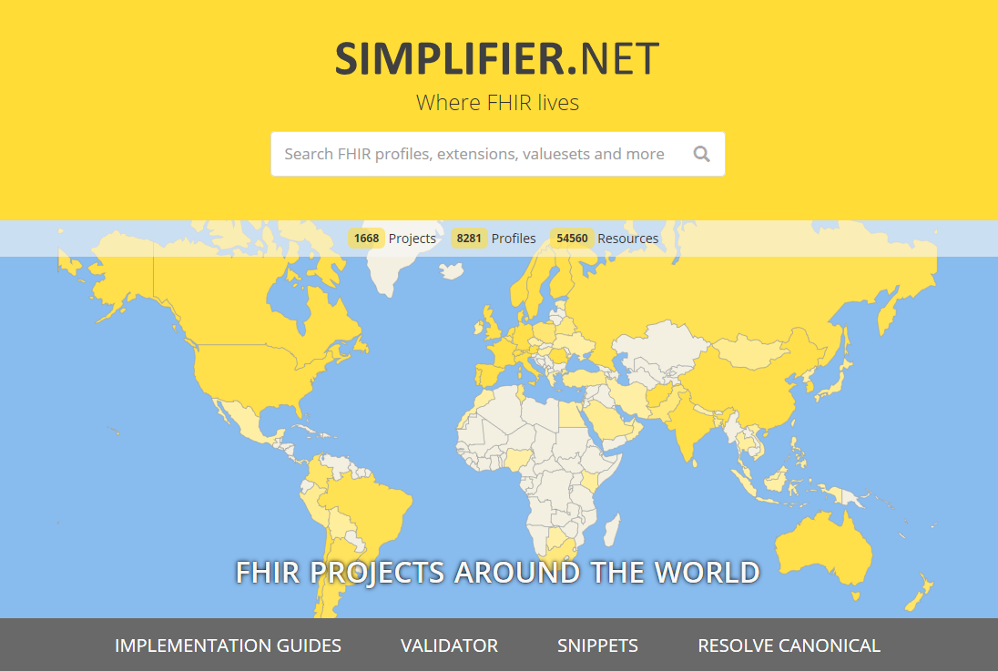
Public FHIR Registry
FHIR NPM Package Server
Search, browse & find FHIR conformance resources:
Profiles, IGs, Valuesets, Examples
Contains:
Official HL7 profiles
HL7 affiliate profiles
Public user profiles
Private company profiles
https://simplifier.net
Notes:
Demo!

Slide 151
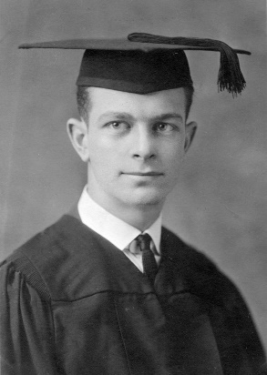
Profiling Academy
Learn to create (better) profiles
https://simplifier.net/guide/profilingacademy/
Short, digestible training modules
Examples & Exercises

Slide 152


FHIR Shorthand (FSH)

Slide 153
FHIR Shorthand
Significant time-savings for authors
Easy source-control management
Less hand-holding than GUI-based solutions
http://build.fhir.org/ig/HL7/fhir-shorthand

Slide 154

Wrap Up - Discussion (Q&A)
https://chat.fhir.org/#narrow/stream/179252-IG-creation
lmckenzie@gevityinc.com

